Slide 1
Communication
Session 18

Slide 2
The transfer of information from a sender to a receiver, with the information being understood by the receiver.

Slide 3
Purpose of communication
Flow of information
Coordination
Learning management skills
Preparing people to accept change
Developing good human relations
Ideas of subordinates encouraged

Slide 4
Factors Contributed to the Significance of Communication:
Advancement of Science and Technology
e.g. Management Information System (MIS)
2. Faster means of Transport
e.g. phones, emails, fax
3. Globalization of Business
e.g. dealing with customers, vendors,distributors,competitors etc.
4. Information revolution via networking technologies
e.g. company intranet
5. Advancement in social sciences such as psychology and sociology
e.g. human mind and social behavior influencing communication

Slide 5
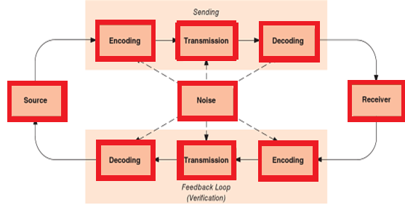
The communication process

Slide 6
Communication Process
Communication process constitutes of the following:
Sender
Originates the process
Has an idea, a piece of information, an experience, a request, a command to be shared with another.
2. The message
The information encoded by the sender is the Message.
Should be well formulated, faultless in thought and language and should be clear.
3. Channel or Medium
The message is transmitted through a channel, may be verbal or nonverbal, spoken or written.
It may be a medium such as telephone, letter, email etc.

Slide 7
4. The receiver or recipient
Complete understanding of the message should be there.
5. Feedback
It is the response generated by recipient.
It leads to effective decision making.
6. Noise
It is the disturbance of any kind that affects communication at any stage along the process.
e.g. ill formed idea sent by sender e.g. faulty logic
Faulty language and lack of clarity in idea
Choice of wrong channel

Slide 8
Seven C’s of Effective Communication:
Clear.
Concise.
Concrete.
Correct.
Coherent.
Complete.
Courteous.

Slide 9
An effective communication can benefit the organization in:
Quicker problem solving
Stronger decision making
Steadier work flow
Increased productivity
Stronger business relations

Slide 10
Forms of communication
Written communication
Oral Communication
Non-verbal communication

Slide 11
Barriers in communication
All Communication is subject to misunderstandings, business communication is particularly difficult as the material is often complex. Moreover, both senders and receivers may face distractions that divert their attention. Further, opportunities for feedback are often limited, making it difficult to correct the misunderstandings, thus ultimately leading to the breakdown in communication.

Slide 12
Barriers in communication
Organizational Structure
Difference in status
Lack of trust
Closed communication climate
Incorrect choice of medium
Information overload
Message complexity
Message competition
Unethical communication
Physical Distractions

Slide 13
Guidelines for improving communication
Clarify the purpose of the message
Use intelligible encoding
Consult other’s views
Consider receiver’s needs
Use appropriate tone and language and ensure credibility
Get feedback
Consider receiver’s emotions and motivations
Listen

